Slide 1

Harewood hints and tips for parents and carers

Slide 2
The Primary Behaviour Service is a team of dedicated practitioners, with extensive experience of working in primary schools, to promote children’s positive behaviour and emotional wellbeing.
We believe:
That behaviour is a metaphor for communication;
Every child deserves to be heard, and can be taught strategies to succeed;
Every child has the right to equality of opportunity and inclusion, and to have their individual needs met through a child-centred approach;
In early targeted support to develop optimal independence and emotional resilience; and
Every child can flourish, develop their individual strengths and make a valuable contribution to society.

Slide 3

“Thank You”, not “Please”
Really important, this one! Say “Please” too often and you may sound like you are pleading! Have a look at these examples.
“[Child’s Name], [Instruction], Thank You”
Holly refuses to put her toys away: “Holly, toys in box, thank you”
Billy refuses to put his trousers on: “Billy, trousers on, thank you”
Alfie is jumping up and down on settee: “Alfie, bottom on settee, thank you”

Slide 4

Nice and Nice
A child reluctant to start adult instruction can be given to positive options to choose from
“Are you going to use the a spoon or a fork to eat your dinner?”
“Are you going to wear your pink tights or your white tights?”
“Are you going to do your homework with a pen or pencil.?”
“Are you going to tidy up your toys with your monster hands or crab hands?’’
This gives the child a ‘win – win’ choice.

Slide 5
Nice and Nasty
Nice
Nasty
Use a matter of fact, controlled calm voice:
“Either it’s finished/tidied now, or it will have to be done instead of us going to the park.”
“You need to come off your [device] now or you wont be able to use it tomorrow”
“Your toys need to go away now or during TV time.’’

Slide 6

Take Up Time
Confidently give the instruction, turn/walk away, with the expectation that your child will comply.
‘’I can see your not wanting to tidy up’’
‘’I wonder if your struggling eating your vegetables?”
‘’Wow! This is really hard for you to come off the iPad!’’
‘’Tell me if I’m wrong, but I imagine you felt sad that we didn’t go for ice cream.’’

Slide 7

Ear-shotting
The technique of speaking aloud within the child’s ear shot can be used in a variety of ways. The adult speaks out loud to another adult or child in the room within the child’s ear shot.
“Wow, I’m so proud of Zac this morning, helping me with breakfast dishes. When he’s finished putting his toys away, I’m wondering if he would like to bake some cakes?”
“Dad, I think Lucy can do her homework if she reads it carefully, but I’m wondering if she would like one of us to help?’’
‘’Thomas [brother], I can see that Finlay’s cheeks are very red. I’m wondering if he’s cross you took the toy from him?’’

Slide 8

The Never Say No
Sometimes we have to say “No”, but for other times try this- “Yes, as soon as you have…”
“I want Megan round to play today’’
“Yes, she can come round, although not today. She can come on…’’
“Can I go on the iPad?”
“Yes, as soon as you’ve finished tidying away the game you have just been playing with”
“Can I have a biscuit?’’
“Yes as soon as you have finished your sandwich.’’

Slide 9

Don’t say Don’t
Frame an instruction positively. We often give children ideas of what to do when we are trying to get them to stop.
Try this, especially when restating rules:
“Walking down the stairs, thank you”
rather than “Don’t jump!”
[waiting to go out the front door] “Remember we walk together”
“Put that down thank you’’ rather than “Don’t throw that’’

Slide 10
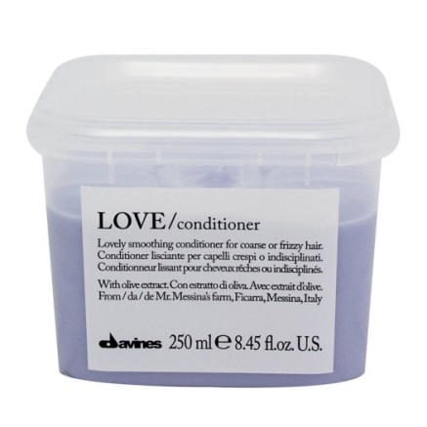
Use Conditioner
Using the phrase “When.. Then…’’
“When I have finished in this shopping, then we can go home”
“When you have brushed your teeth, then we can have a story”
“When you have finished the last sentence, then you can have 30 minutes on your device’”

Slide 11
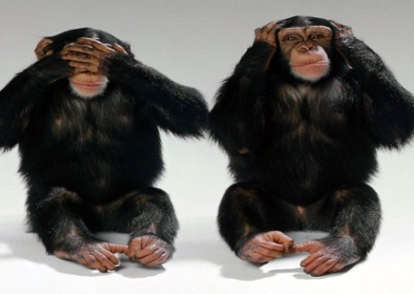
Tactical Ignoring
The “I can’t hear or see you”, otherwise known as tactical ignoring, is choosing not to tend to an unwanted behaviour.
[Child calling parent from settee] “Mum, I’m hungry!” [Adult ignores]
[Talking to another child] “Mia you are sat really nicely at the table waiting for your dinner”
“Remember, when you’re sat at the table, then I will bring your dinner out” [gives other child their dinner] [Immediately tend to child as soon as they sit at the table]

Slide 12

Don’t Lose Face
The “Ask Permission Before Doing”. With impulsive children it can be hard, initially, to stop them doing the things they want to do.
In these situations, e.g. in the supermarket, it may be worth trialling this strategy.
“Emma, hold my hand, thank you. You need to use your words to tell me what you want”
[Emma uses her words], “Yes, thank you for asking” [then go to look for the item]
Initially (where appropriate), try to say yes as much as possible so that the child gets used to the idea that asking permission gets her what she wants.
This is one step towards regulating impulses, in that it can be used to bridge the gap between saying “No” outright (and then the child doing it anyway), and “Yes, but only with my permission”. If used carefully, this can prevent the adult losing face.

Slide 13

Pause for thought
before acting.
Stay positive!
Allow time for your own recovery, you’re human too!
Keep perspective…
think of something nice!
Give
space.
Stay
Calm!
Keep your emotions
in check.
Use a change of face when you can or need to.
Don’t be afraid to
ask for help
Check your body language?

