Slide 1

Developing our knowledge of Brazil and Portuguese

Slide 2
Brazil (officially called Federative Republic of Brazil; is a country in South America. It is the world's fifth largest country.
The country has about 209 million people. The capital of Brazil is Brasília.
Brazil was named after brazilwood. Brazilwood is a tree that once grew very well along the Brazilian coast.

Slide 3
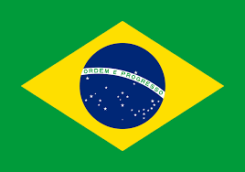
Brazil is the only country in Latin America that speaks Portuguese.

Slide 4
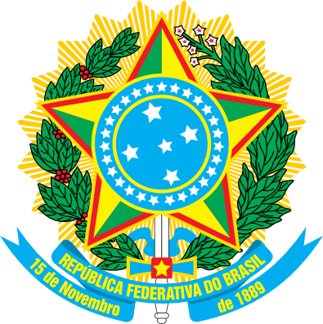

Slide 5
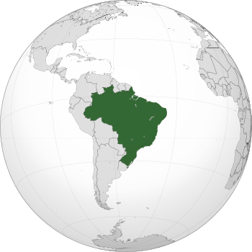
https://www.google.com/maps/place/Brazil/@-13.7017905,-87.629363,3z/data=!4m5!3m4!1s0x9c59c7ebcc28cf:0x295a1506f2293e63!8m2!3d-14.235004!4d-51.92528?hl=en

Slide 6
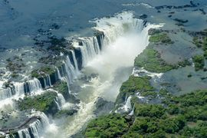
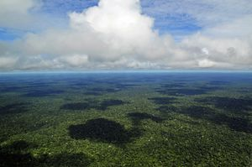
Amazon Rainforest

Slide 7
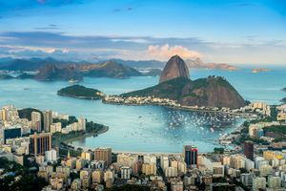
Rio de Janeiro

Slide 8
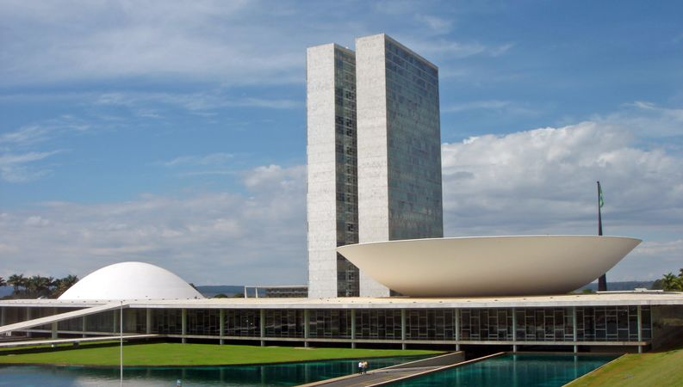
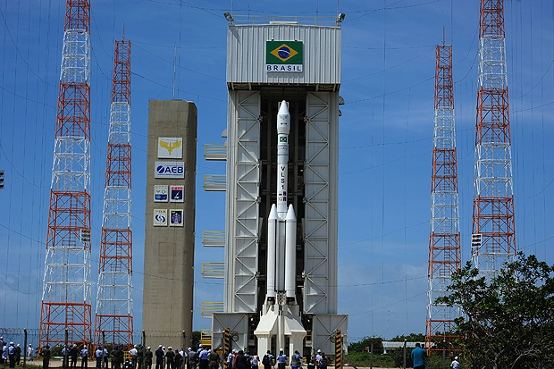

Slide 9
Learn Portuguese
https://www.youtube.com/watch?v=ix_ougC1TNQ
https://www.youtube.com/watch?v=pc0GRj-ec9s

Slide 10
https://www.sciencekids.co.nz/sciencefacts/countries/brazil.html
https://www.audleytravel.com/us/brazil/country-guides/brazil-highlights-guide

