Slide 1

Italy- Italian

Slide 2
https://www.sciencekids.co.nz/sciencefacts/countries/italy.html
https://www.youtube.com/watch?v=-ZK0FeBZKQM&list=PLbW9xRuMuoVY1uiuqGb8jT7lILwTGm-vU
https://www.google.com/maps/place/Italy/@40.9399763,3.7218338,5z/data=!3m1!4b1!4m5!3m4!1s0x12d4fe82448dd203:0xe22cf55c24635e6f!8m2!3d41.87194!4d12.56738?hl=en
https://www.fodors.com/world/europe/italy/experiences/news/20-gorgeous-seaside-towns-in-italy

Slide 3
Italy is a country in south Europe and a member of the European Union.
Its official name is Repubblica Italiana. The Italian flag is green, white and red. Italy is a democratic republic and is a founding member of the European Union.
Italy is also a member of the G8, as it has the eighth largest Gross Domestic Product in the world.

Slide 4
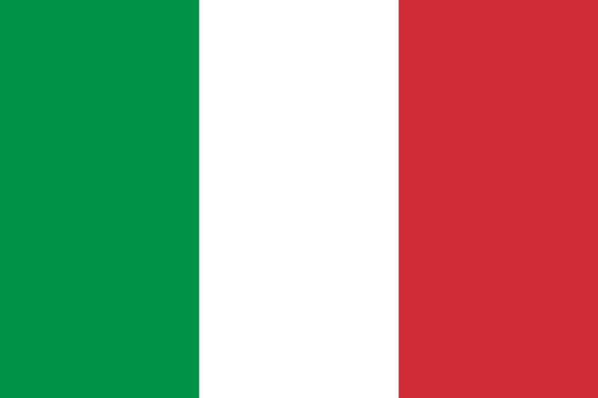

Slide 5


Slide 6
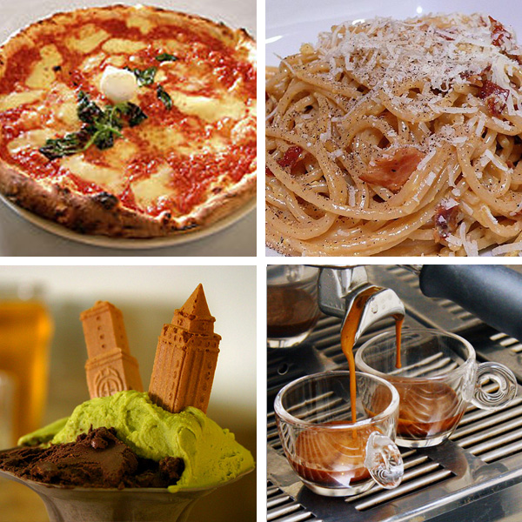
Italy has become famous for its wine, as well as its food. Some foods are different between regions. Famous dishes include various types of pasta, pizza, and grapes. Olives are much used.
The country's capital, Rome, is one of the most famous cities in the world, as it was the capital of the Roman Empire. Other famous cities in Italy include, Venice, Naples,
Genoa, Florence, Palermo, and Milan.

Slide 7
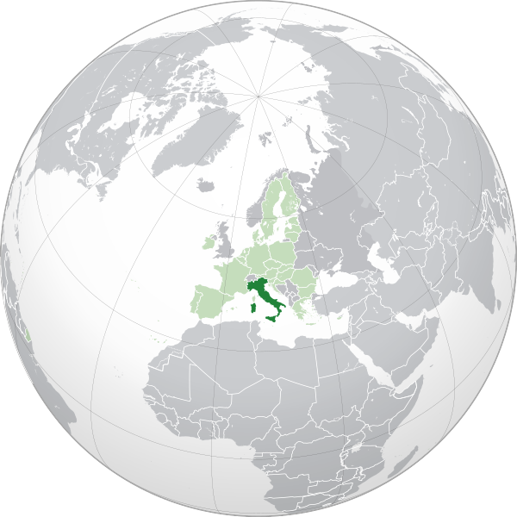
https://www.google.com/maps/place/Italy/@40.9399763,3.7218338,5z/data=!3m1!4b1!4m5!3m4!1s0x12d4fe82448dd203:0xe22cf55c24635e6f!8m2!3d41.87194!4d12.56738?hl=en

Slide 8
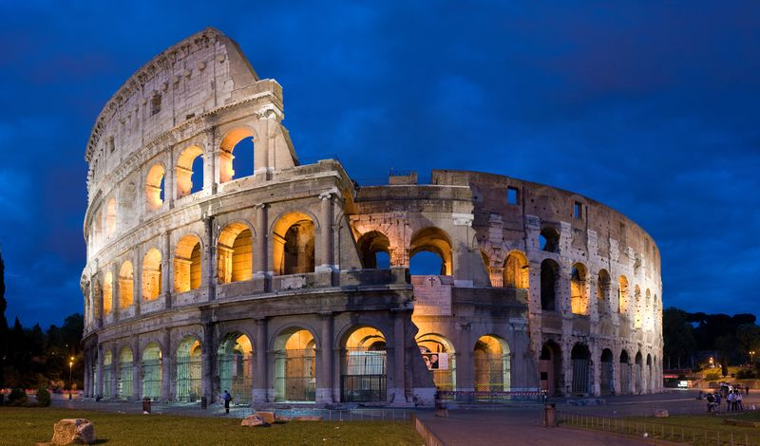
Italy was the centre of the Roman civilization for centuries, Italy lost its unity after the collapse of the Roman Empire and subsequent barbaric invasions.

Slide 9
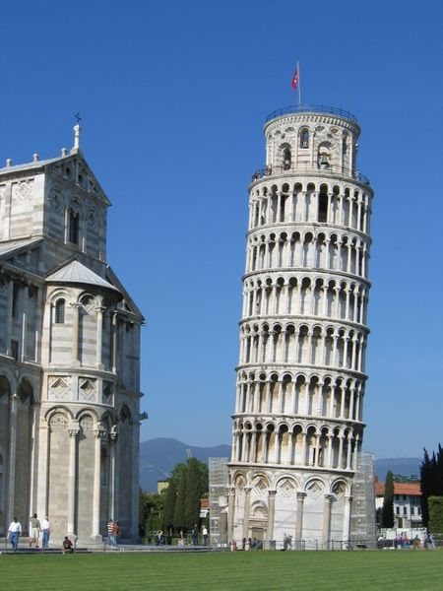

Slide 10
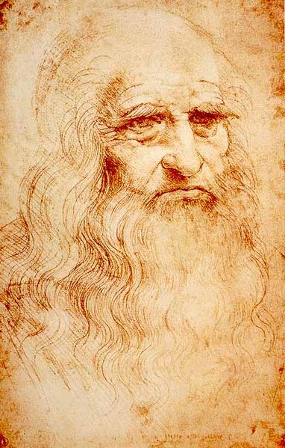

Slide 11
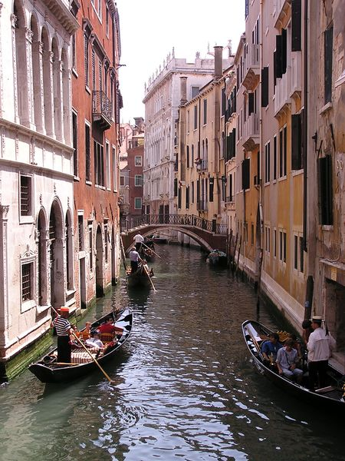

Slide 12
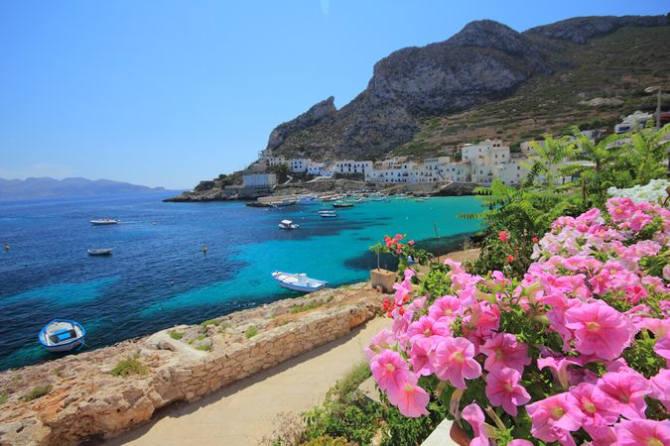

Slide 13
https://www.youtube.com/watch?v=-ZK0FeBZKQM&list=PLbW9xRuMuoVY1uiuqGb8jT7lILwTGm-vU

Slide 14
https://www.sciencekids.co.nz/sciencefacts/countries/italy.html
https://www.fodors.com/world/europe/italy/experiences/news/20-gorgeous-seaside-towns-in-italy

