Slide 1

Nepal- Nepali/Nepalese

Slide 2
Nepal (Nepali: नेपाल) is a country in South Asia bordering the Republic of India and the People's Republic of China. Mount Everest, the highest mountain in the world, is found there, as well as the Himalaya Mountains. 12 of the world's 18 highest mountain peaks are in Nepal. It is also the birthplace of Buddha

Slide 3
Nepal is a very important pilgrimage place for both Hindus and Buddhists. Nepali is the official language, and there are many other regional languages. English and Hindi are widely understood.
The capital city of Nepal is Kathmandu which has a population of over two million people.
The second largest city is Pokhara. Pokhara is a major tourist attraction of Nepal. It is rich in Natural Beauty

Slide 4
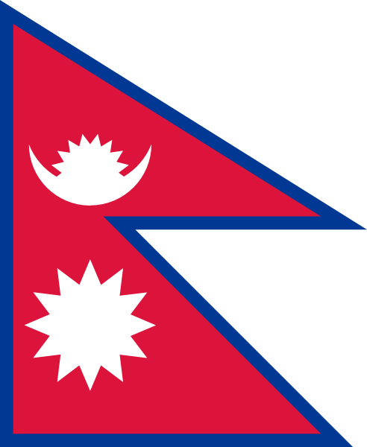

Slide 5
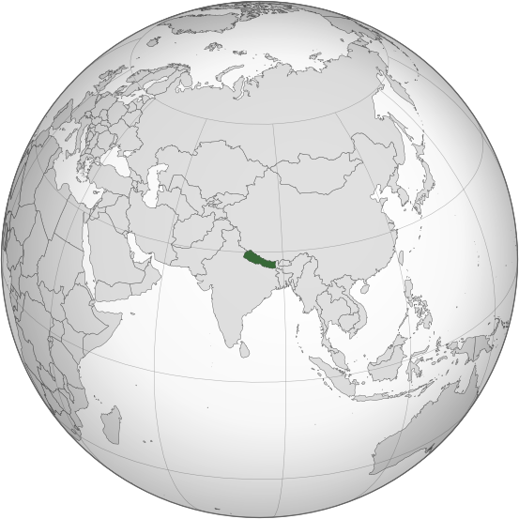

Slide 6
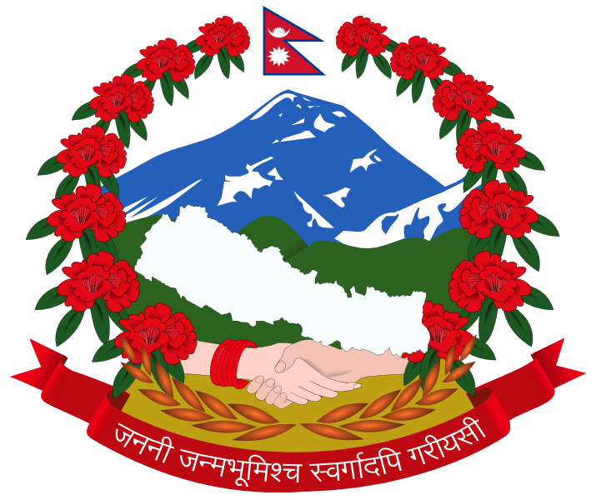
Official languages | Nepali
Demonym(s) | Nepali, Nepalese

Slide 7
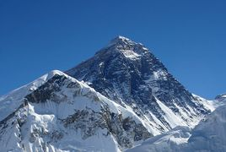
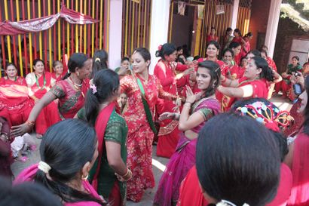

Slide 8
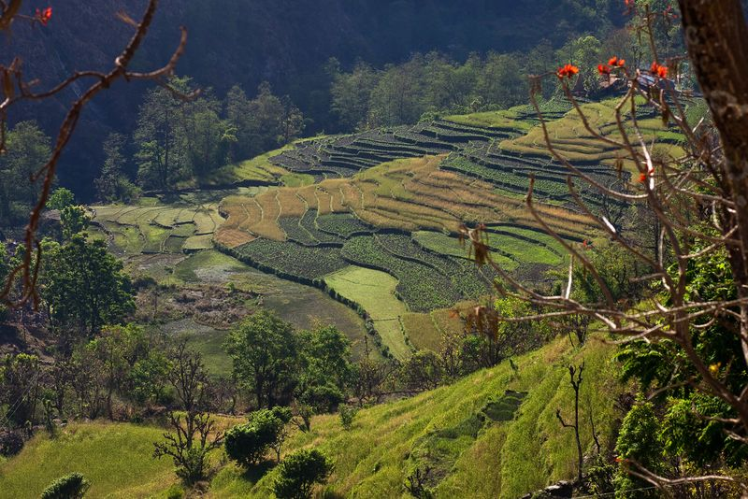

Slide 9
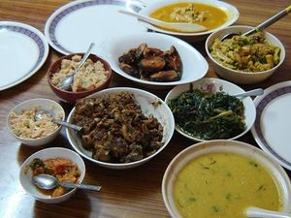

Slide 10
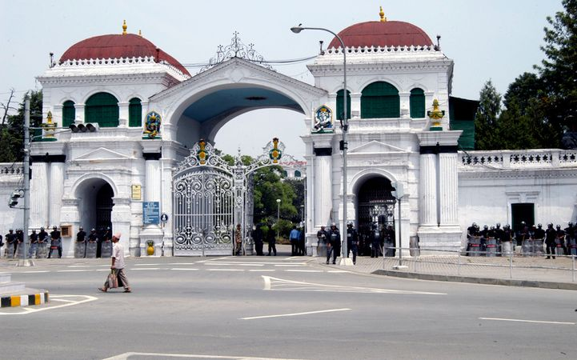

Slide 11
https://www.kids-world-travel-guide.com/nepal-facts.html
http://www.travelmyne.com/asia/nepal

Slide 12
https://www.youtube.com/watch?v=qdGrF5vC2wE

