Slide 1

Developing our Knowledge of Poland and Polish

Slide 2
Poland is a country in Central Europe. It is on the east of Germany .The Czech Republic and Slovakia are to the south, Ukraine and Belarus to the east, and the Baltic Sea, Lithuania, and Russia to the north.
The total land area of Poland is about 312,679 km² (120,728 mi²). This makes Poland the 77th largest country in the world with over 38.5 million people.
Most Polish people live in large cities, including the capital, Warsaw.

Slide 3
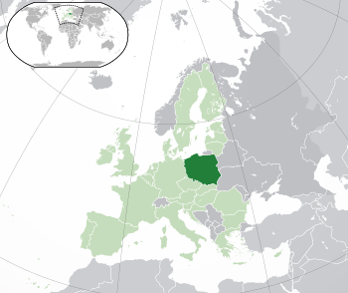
https://www.google.com/maps/place/Poland/@51.8684183,14.6489197,6z/data=!3m1!4b1!4m5!3m4!1s0x47009964a4640bbb:0x97573ca49cc55ea!8m2!3d51.919438!4d19.145

Slide 4
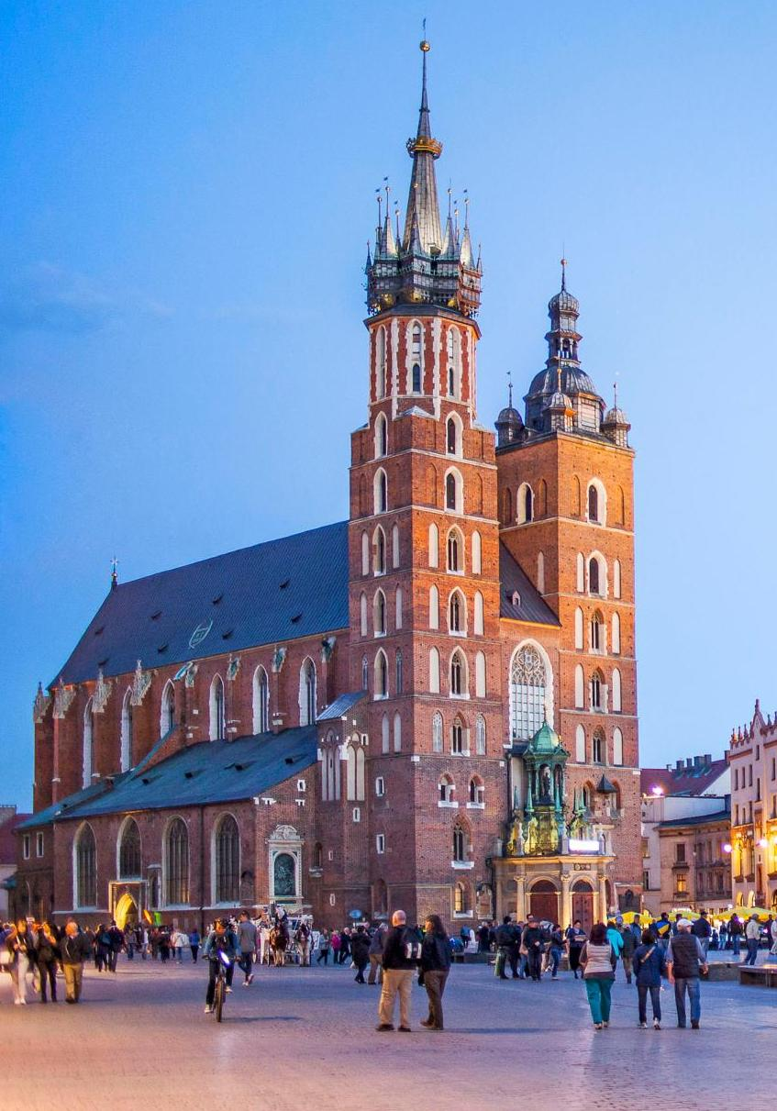

Slide 5
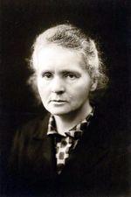
Physicist and chemist Maria Skłodowska-Curie, the first person to win two Nobel Prizes.

Slide 6
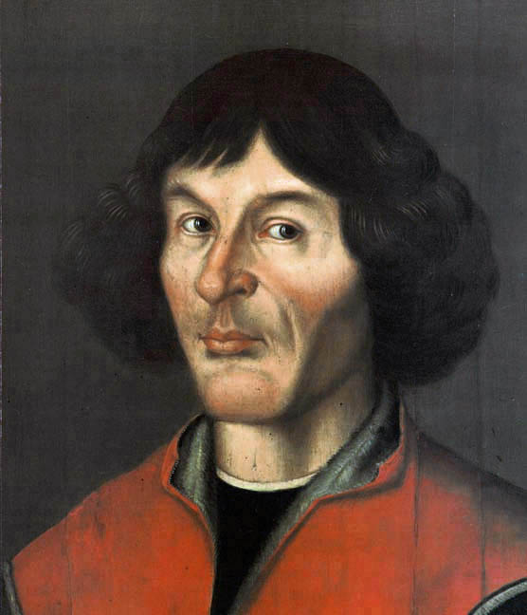
Nicolaus Copernicus, the 16th-century Polish astronomer who formulated the heliocentric model of the solar system that placed the Sun rather than the Earth at its centre—work first published in 1543.

Slide 7
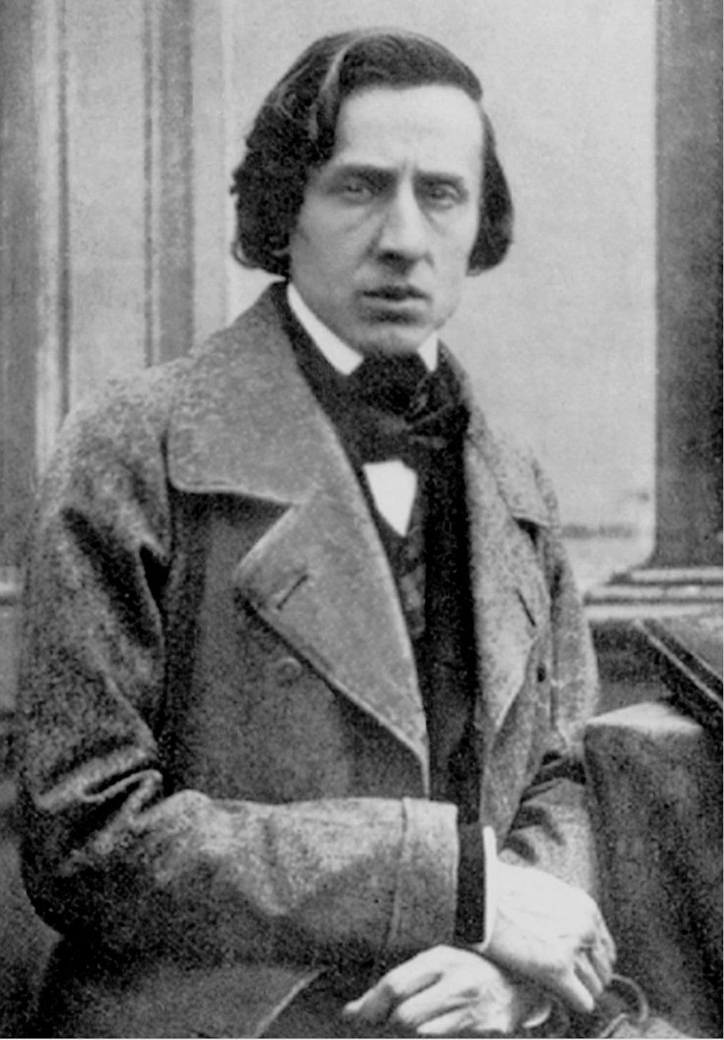
Fryderyk Chopin was a renowned classical composer and virtuoso pianist

Slide 8
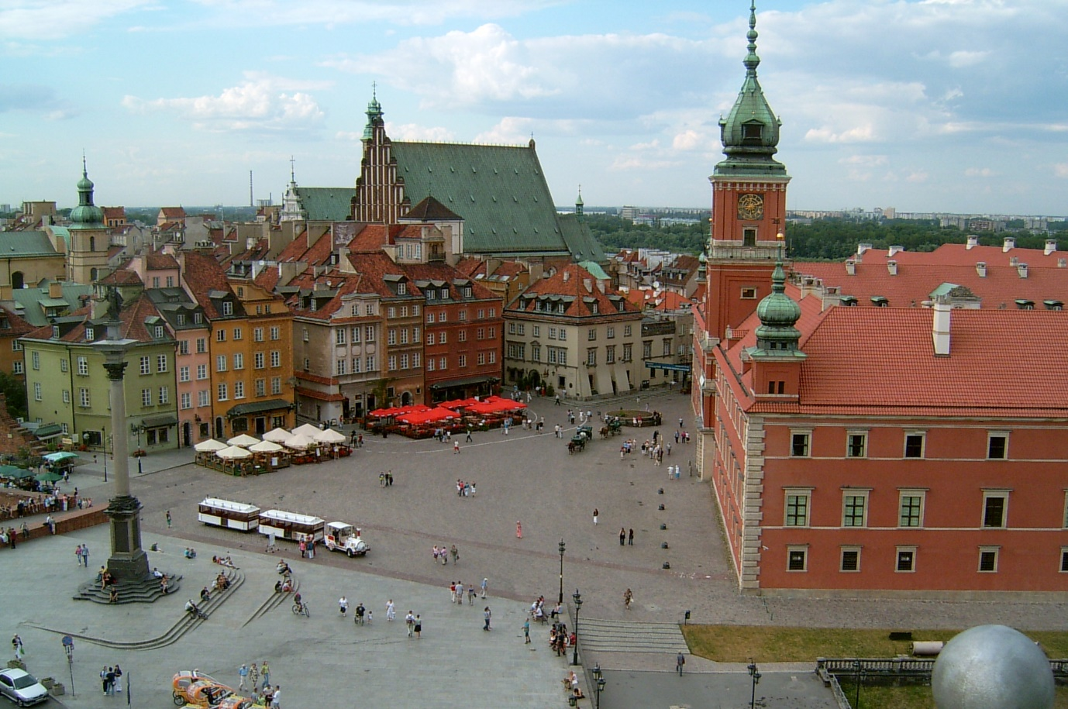

Slide 9
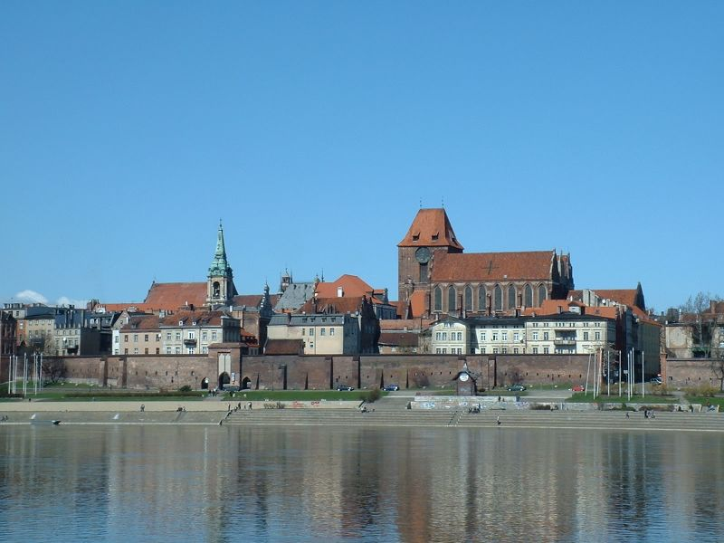

Slide 10
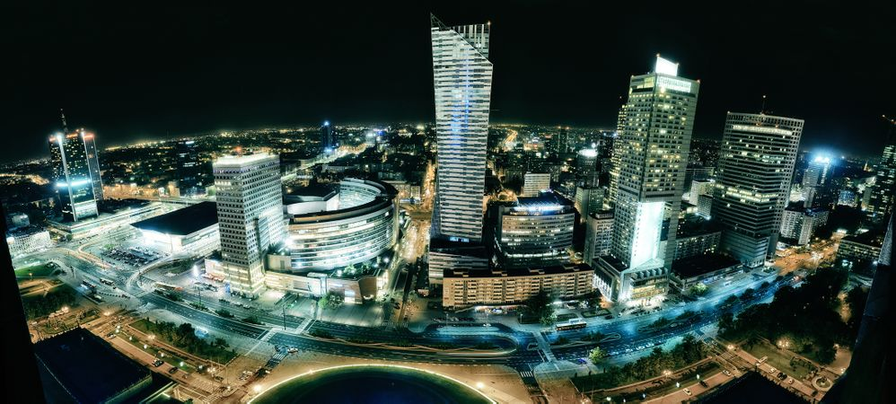

Slide 11
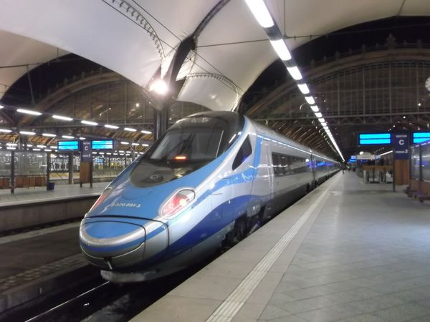

Slide 12
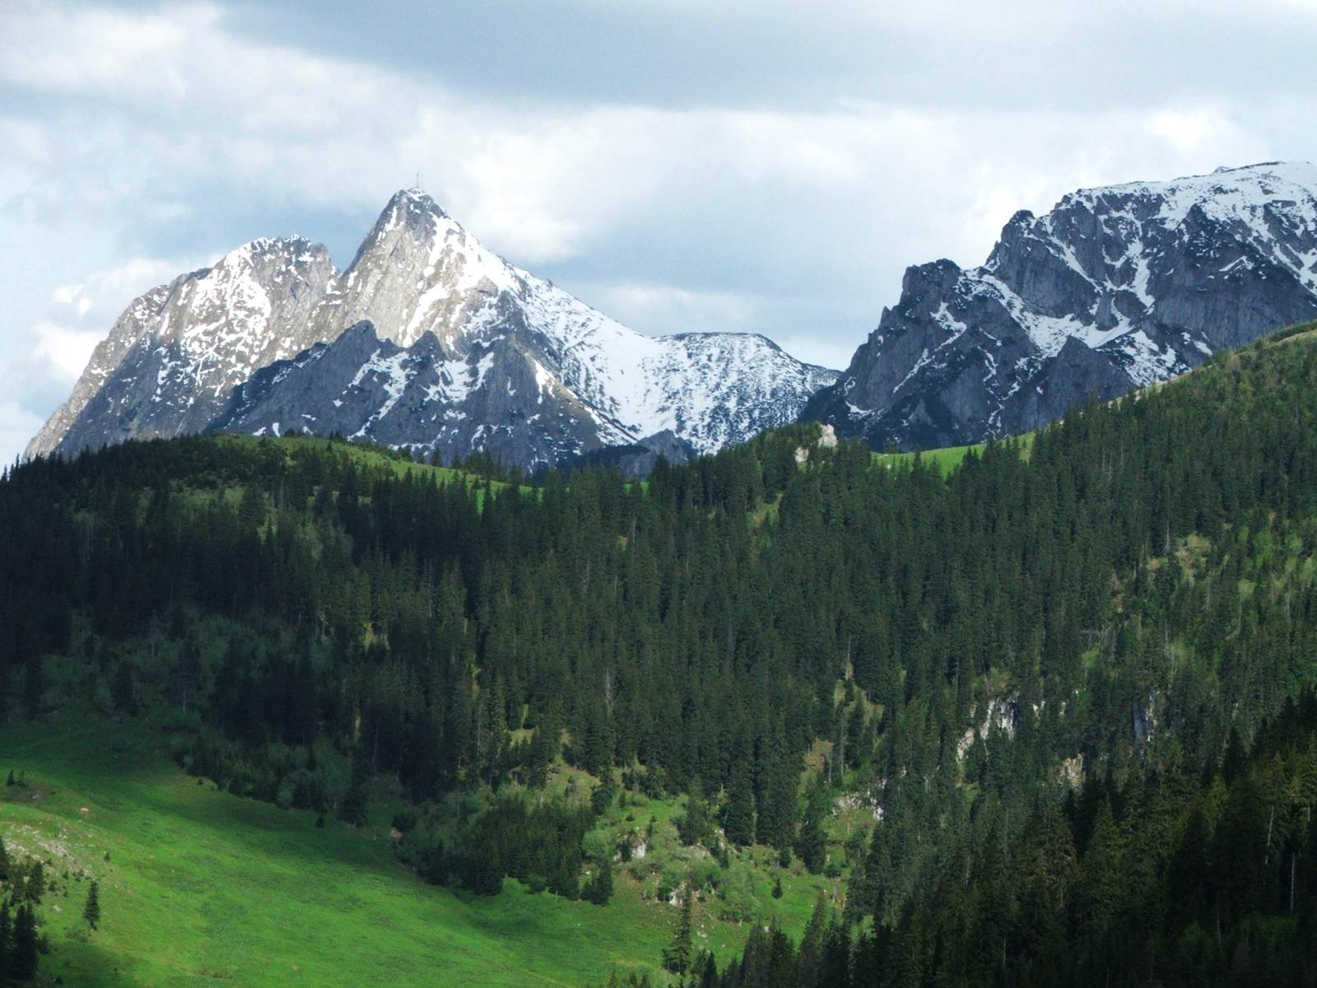

Slide 13
https://www.youtube.com/watch?v=-etOiaiZek0
https://www.lonelyplanet.com/poland
https://www.sciencekids.co.nz/sciencefacts/countries/poland.html

