Slide 1

Developing our knowledge of our Bulgaria and Bulgarian

Slide 2
Bulgaria
Bulgaria (officially called the Republic of Bulgaria) is a country in south eastern Europe.
The capital and the biggest city is Sofia.

Slide 3
The population of Bulgaria is a little more than 7 million people.
Bulgaria has its own language, called Bulgarian. It is a type of Slavic language. It is related to languages like Serbian and Russian.
Bulgaria became independent in 1908 from the Ottoman Empire.
Bulgaria borders Romania, Serbia, the Republic of Macedonia, Greece, Turkey, and the Black Sea.
Bulgaria is an ancient country, some places have had people living there for over 6,000 years.

Slide 4
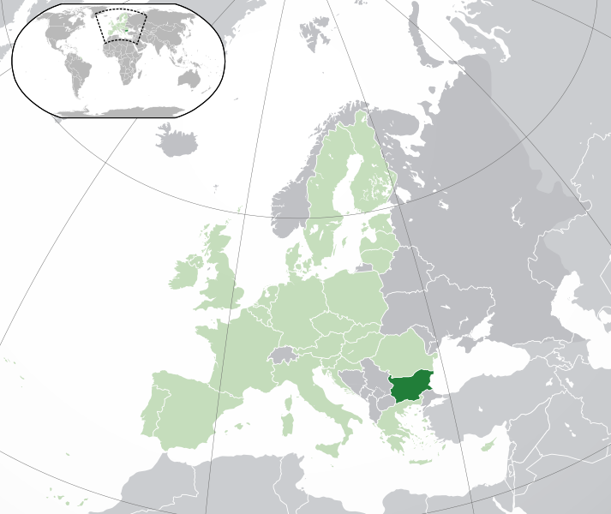
https://www.google.com/maps/place/Bulgaria/@42.6376485,7.6070041,4z/data=!4m5!3m4!1s0x40a8fec1c85bf089:0xa01269bf4c10!8m2!3d42.733883!4d25.48583?hl=en

Slide 5
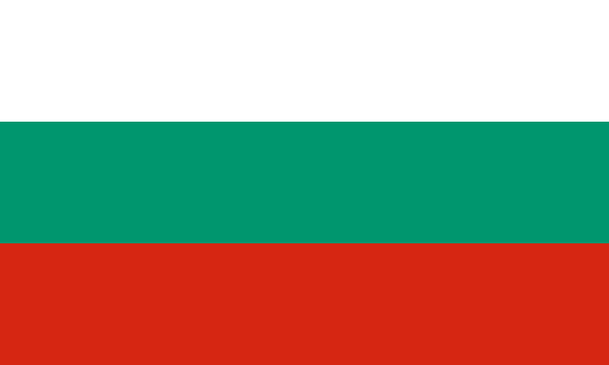

Slide 6
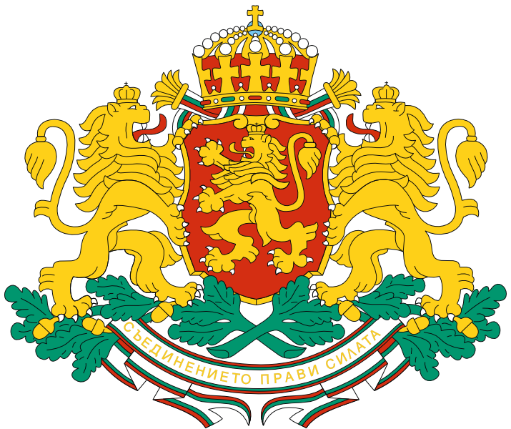

Slide 7
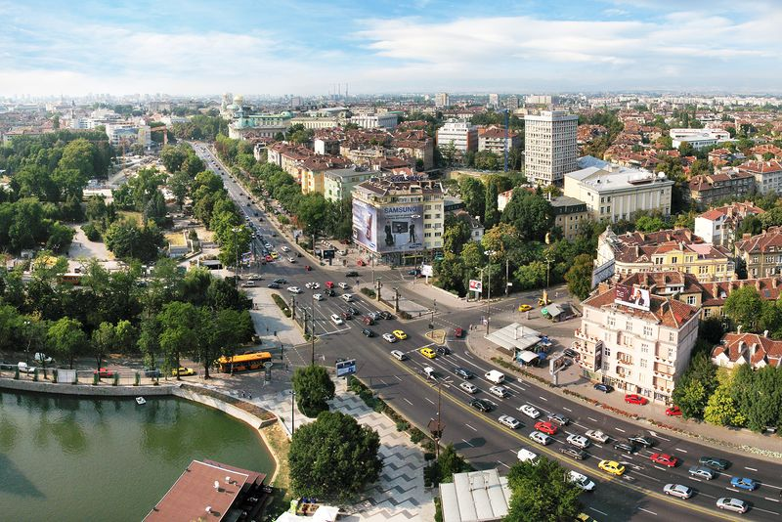

Slide 8
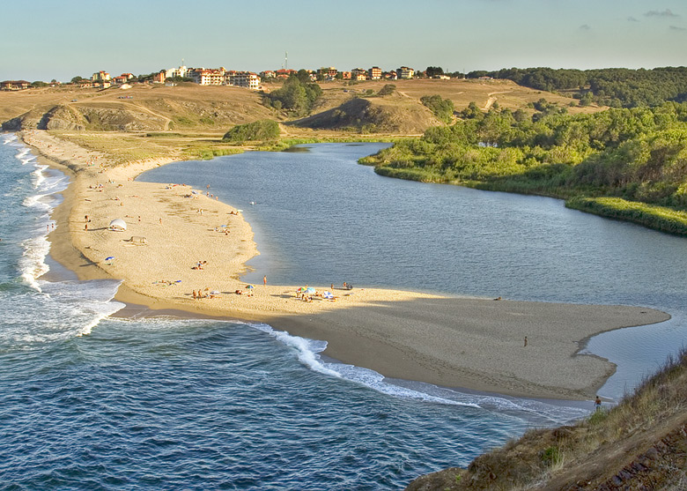

Slide 9
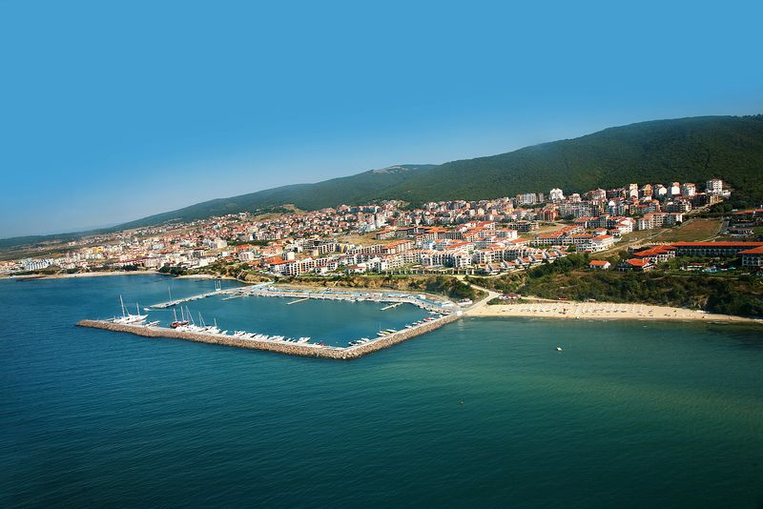

Slide 10
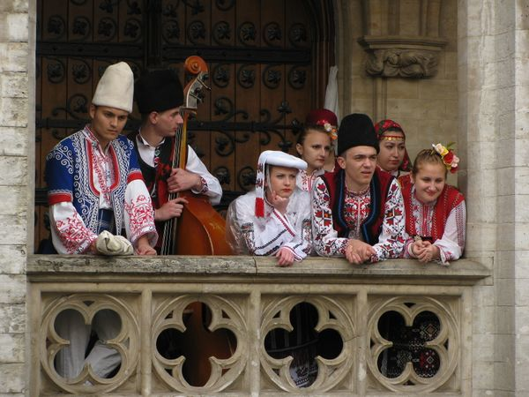

Slide 11
https://www.youtube.com/watch?v=lC5qZ1wM1Iw

Slide 12
https://www.worldtravelguide.net/guides/europe/bulgaria/
https://www.google.com/maps/place/Bulgaria/@42.6376485,7.6070041,4z/data=!4m5!3m4!1s0x40a8fec1c85bf089:0xa01269bf4c10!8m2!3d42.733883!4d25.48583?hl=en

