Slide 1

Hong Kong- Cantonese

Slide 2
Hong Kong
The Hong Kong Special Administrative Region is one of two Special Administrative Regions (SARs) of the People's Republic of China (the other is Macau).
It is one of the richest and most highly developed places in China and even the world. Hong Kong grew quickly in the decades after World War II. It is now a famous world class financial centre.

Slide 3
The population of Hong Kong is more than seven million. The economy has rapidly grown from a trading port to a very rich city.
Hong Kong is divided into 3 main parts:
Hong Kong Island
Kowloon
New Territories (including 235 outlying islands)
Hong Kong was a British colony from 1842 to 1997 because China lost the Second Opium War. After the Handover, Hong Kong became a part of China

Slide 4
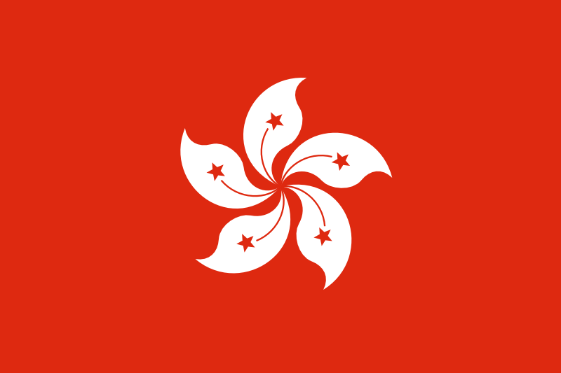

Slide 5


Slide 6
Official languages | Chinese, English
Spoken languages | Cantonese, English, Mandarin
Writing systems | Traditional Chinese, English alphabet
Demonym(s) | Hong Konger

Slide 7
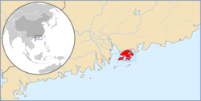
https://www.google.com/maps/place/Hong+Kong/@22.3526632,96.1980018,4z/data=!4m5!3m4!1s0x3403e2eda332980f:0xf08ab3badbeac97c!8m2!3d22.3193039!4d114.1693611?hl=en

Slide 8
Hong Kong is in a tropical area, and has monsoon winds. It is cool and wet in winter (Jan-Mar), hot and rainy from spring through summer (Apr-Sep), and warm, sunny and dry in the autumn (Oct-Dec). The rainy season is from May until September. In summer and early autumn, there is a frequent threat of typhoons.

Slide 9
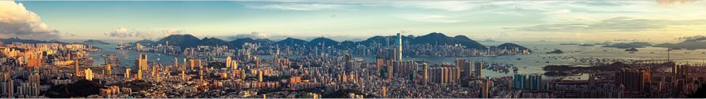

Slide 10
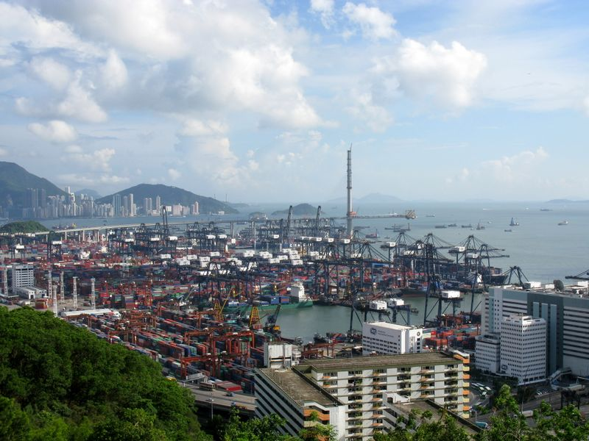

Slide 11
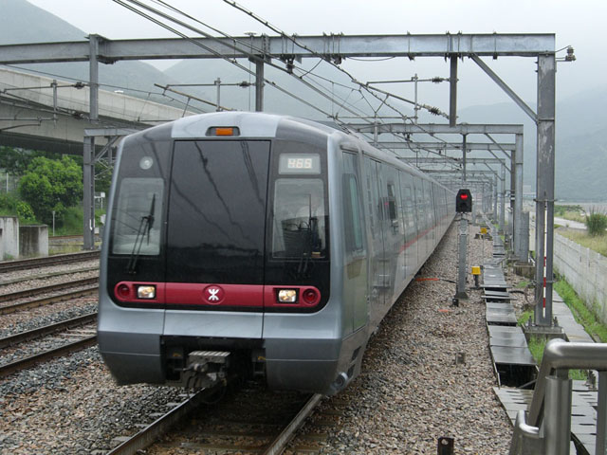

Slide 12
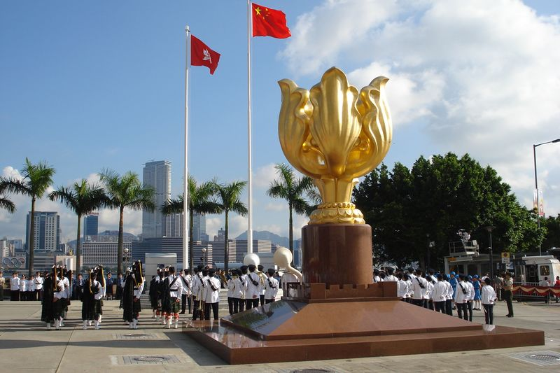

Slide 13
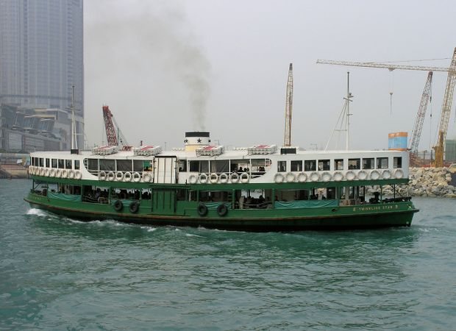

Slide 14
Learn some Cantonese
https://www.youtube.com/watch?v=inwSTVGH5Lk

Slide 15
https://www.wanderlust.co.uk/destinations/hong-kong/
https://www.youtube.com/watch?v=b9qEgM_dCGA&list=PLJZz4wSt4X7Xkt3cSZg_I2myTnKPjmjwc

