Slide 1

Year 6
Willow Class
Information Meeting
2025-2026

Slide 2

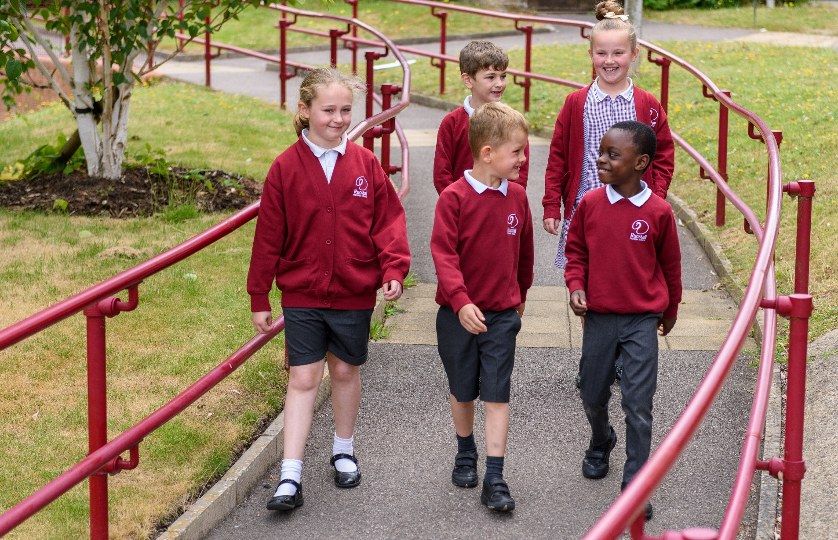
Our School Aims
A caring, fun loving, learning community

Slide 3
Our School Values
Celebration
Co-operation
Creativity
Equality
Honesty
Perseverance
Respectfulness

Slide 4

Rucstall Safety Passport

Slide 5
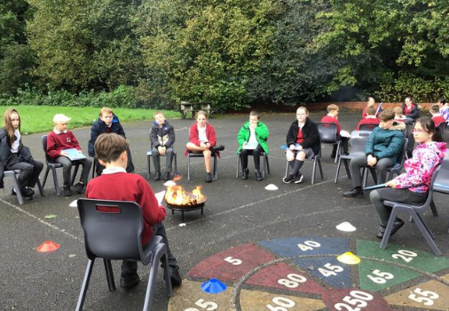
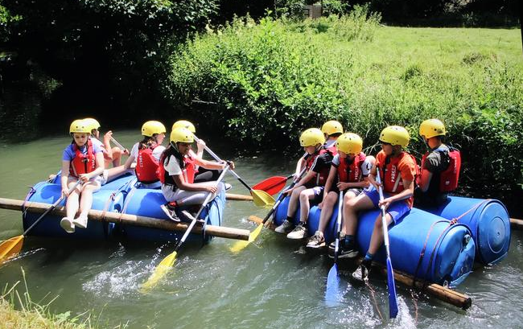
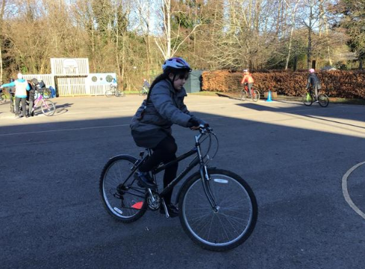
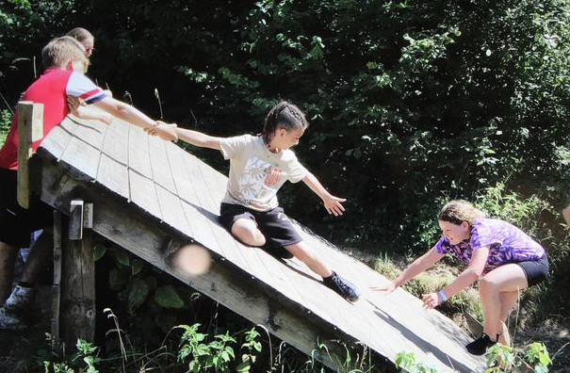
Exciting Opportunities this year
Reading horror stories around a camp fire
Residential Visit

Slide 6





Reading in Year 6
Comprehension skills:
  Vocabulary
  Infer
  Predict
  Explain
  Retrieve
  Summarise
Reading Fluency
Enjoyment and pleasure for reading

Slide 7

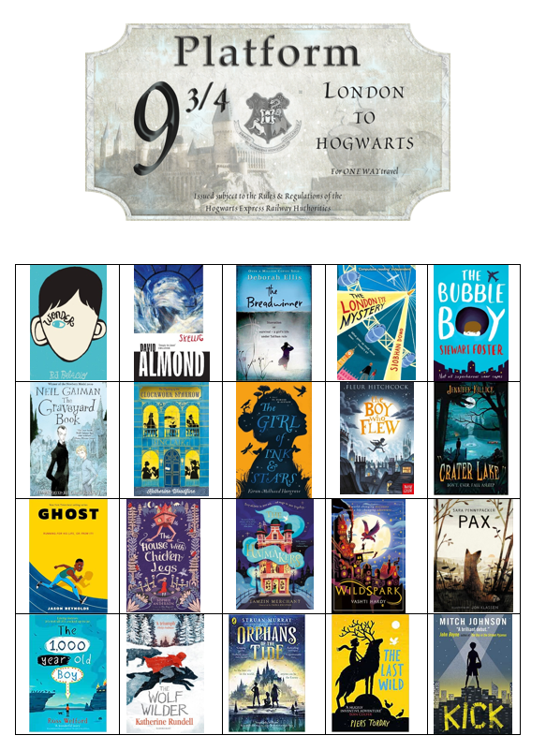
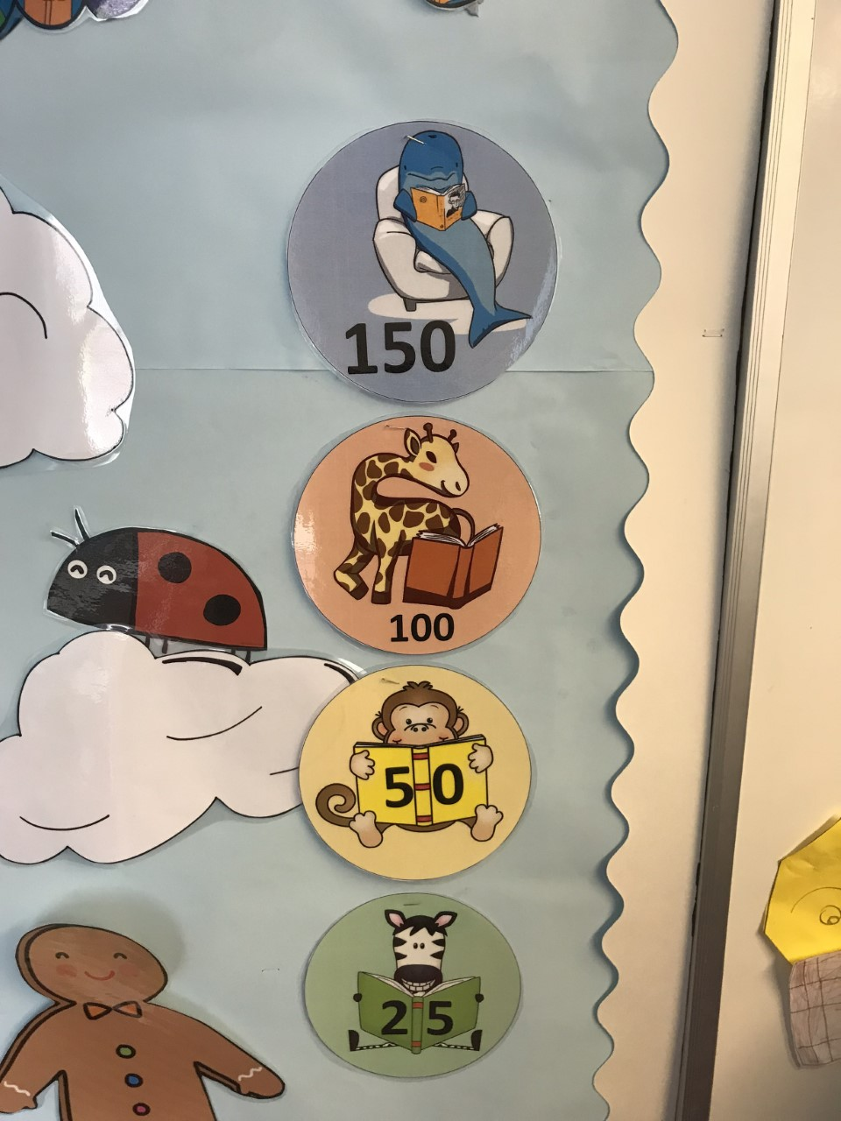
Reading in Year 6

Slide 8
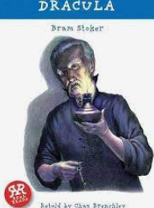
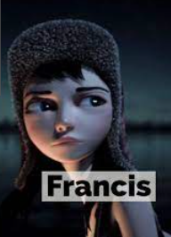
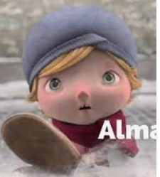

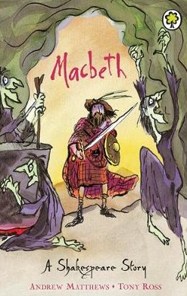
Writing in Year 6
Creating a diary from a different viewpoint based on Dracula
Narrative based on Francis
Letter of complaint about the conditions at Camp Green Lake in Holes
Non-chronological report on yellow spotted lizards in Holes
Letter of complaint about the training conditions in Stormbreaker
Explanation text – creating a new spy gadget
Narrative – recounting events from the video clip Alma
Newspaper report on the disappearance of Alma
Diary entry based on the Island picture book
Dialogue to advance the action between characters in the Island
Monologue and newspaper report based on MacBeth

Slide 9
Mathematics in Year 6
Place value
Four operations - addition, subtraction, multiplication and division
Fractions, decimals and percentages
Measurement – converting units of measure and finding the area, perimeter and volume
Geometry – shape and then position and direction
Ratio
Algebra
Statistics

Slide 10

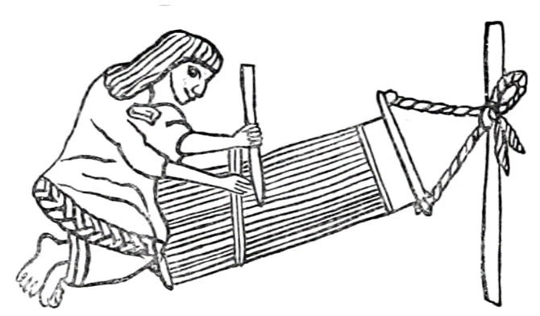


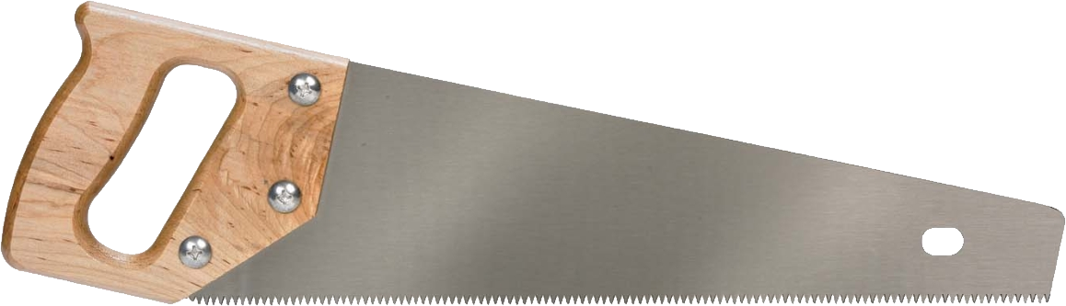
The Wider Curriculum
Weaving in Art
Mayans in History
Light in Science
Relationships and family dynamics
Shelters in DT

Slide 11
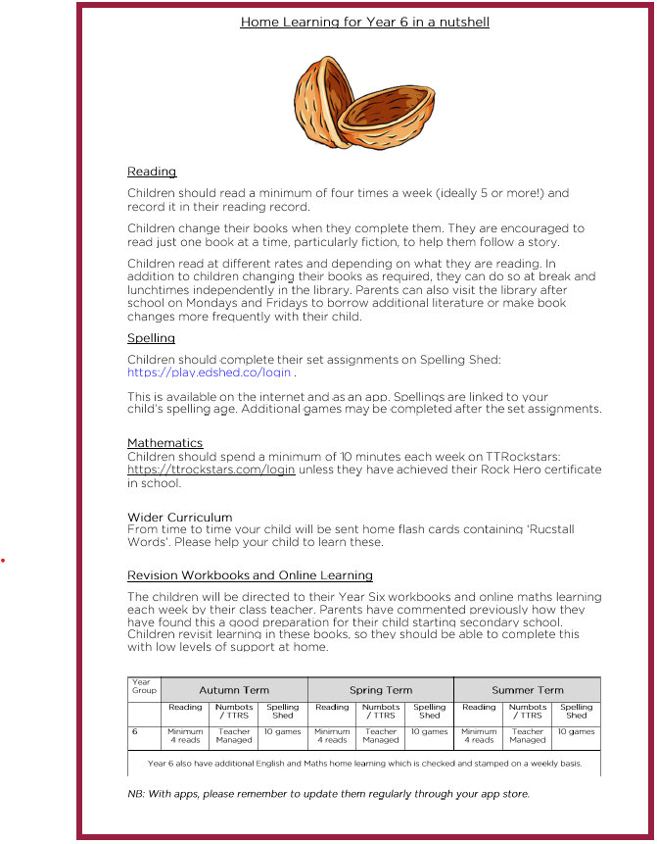

Home Learning Expectations

Slide 12
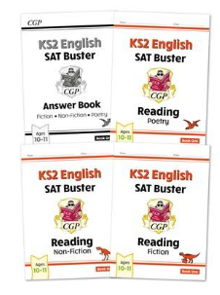
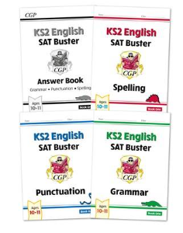

Home Learning Expectations
Workbooks
Mathematics

Slide 13
Home Learning Expectations
Home Learning will be checked for all children on Wednesdays.
Children who do not complete their home learning will do so during their free time.
Year 6 children will also be expected to complete any extra missed home learning.
During holidays, only reading be checked.

Slide 14
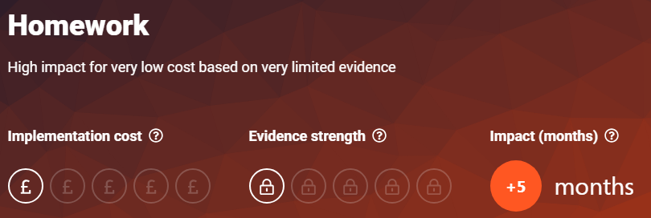
Home Learning Expectations
Rewards:
Group celebration
End of year celebrations
Certificates
Feeling Good
Learning

Slide 15


Home Learning Expectations
Year 6 Book Selection
Notes:
To promote reading within our school and to encourage the pleasure of reading more challenging texts, we have a specific Year Six book selection. Within the library we have an additional reading section where these books can only be borrowed by pupils in this year group.
We believe that it is important the children’s reading abilities are challenged and this means giving them access to a range of different authors and books. Books marked 11+ or teen are included in our Year Six selection and can include some varieties in vocabulary, including swear words, alongside more mature content. Although the content of these books and the vocabulary can be slightly risqué at times, we believe that using more challenging books can support the children’s learning, provided they take a mature and sensible attitude.
Please tell us if you don’t want your child to have access.
We understand that not all parents/carers are happy for their child to have access to this content and would ask that you indicate your permission for your child to access these books. The class teacher will discuss methods for dealing with more mature content and the children will be encouraged to speak to an adult if they would like to talk further about

Slide 16
Supporting my child
Support them to be independent, ready them for secondary school!

Slide 17

Thank you!
We all look forward to working together again this year

