Slide 1


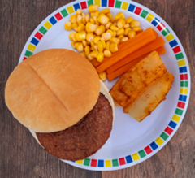

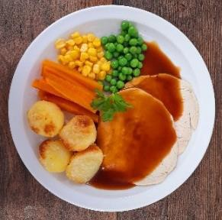
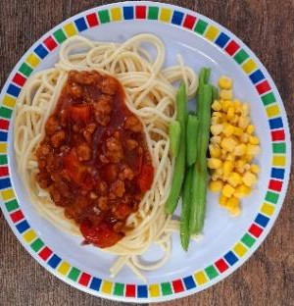
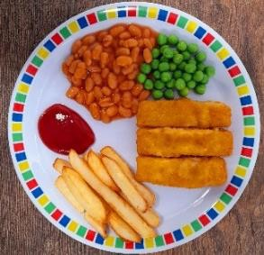
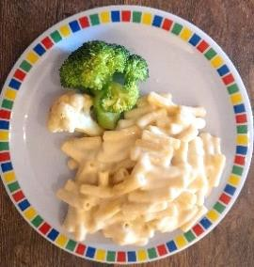

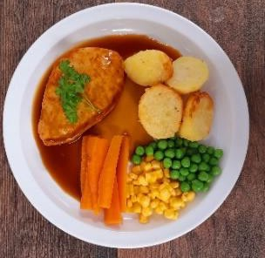
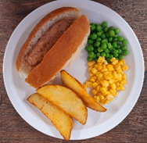
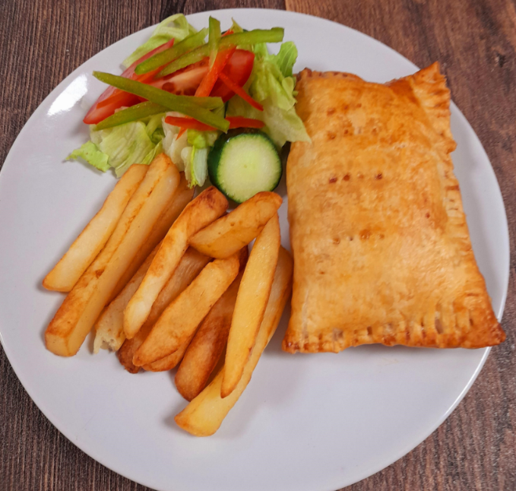
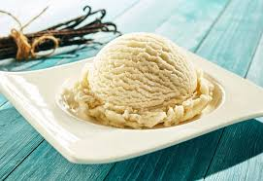
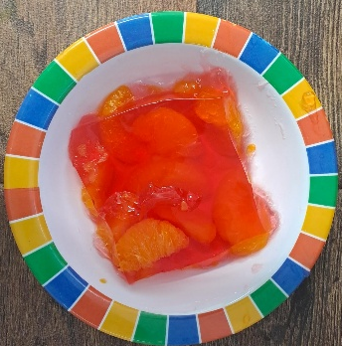
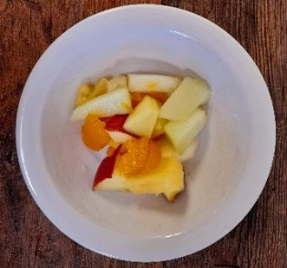
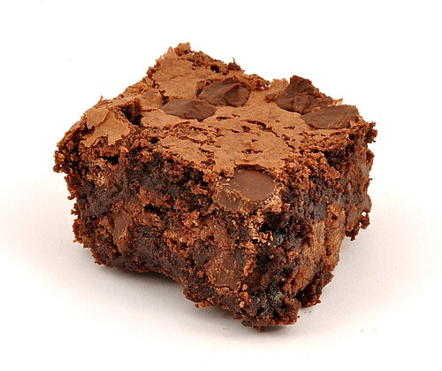
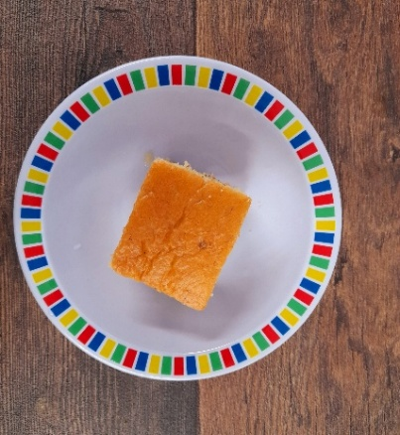
WEEK ONE
 | MONDAY | TUESDAY | WEDNESDAY | THURSDAY | FRIDAY
OPTION 1 | Chicken burger in a bun with wedges | Phat Pasty Pork Sausage Roll with Potato Wedges | Roast Chicken, Stuffing, Roast Potatoes & Gravy | Spaghetti Bolognaise | Fish Fingers or Salmon Fish Fingers with Chips & Ketchup
OPTION 2 | Macaroni Cheese | Pizza Baguette | Roast Quorn, Roast Potatoes & Gravy | Vegan Hotdog | Cheese & Bean Pasty with Chips & Tomato Ketchup
DESSERT | Ice cream | Jelly with Mandarins | Fruit Platter | Brownie | Ornage Drizzle Cake
*VEGETABLES AND SIDES MAY DIFFER THAN THOSE SHOWN

Slide 2


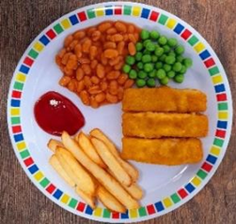
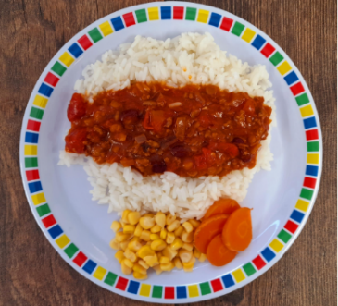

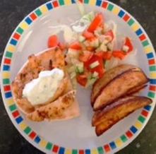
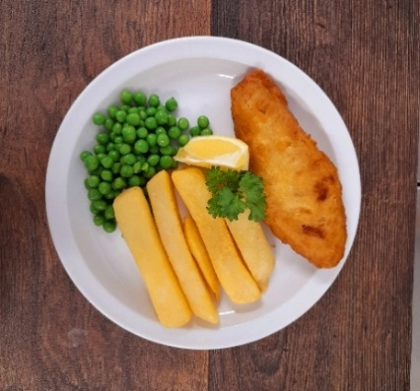
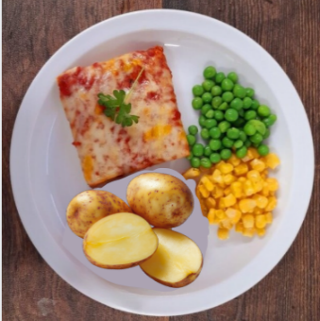
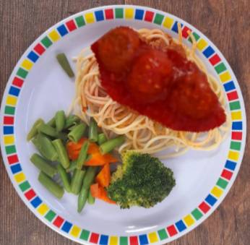
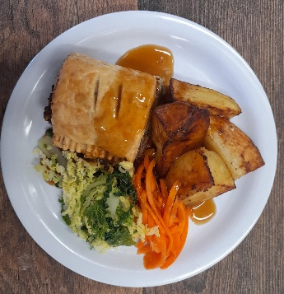
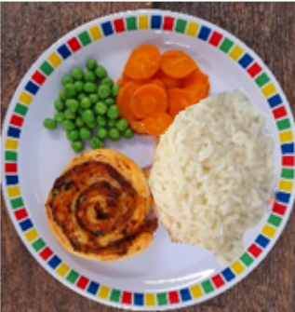
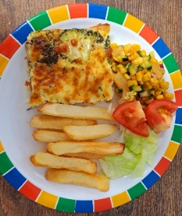
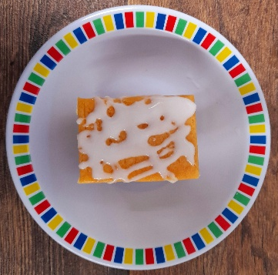
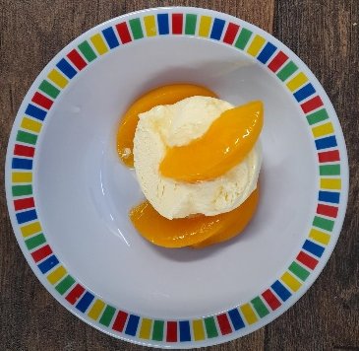
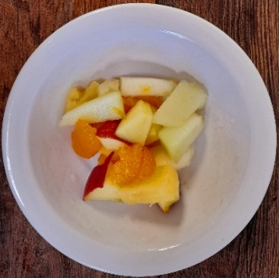
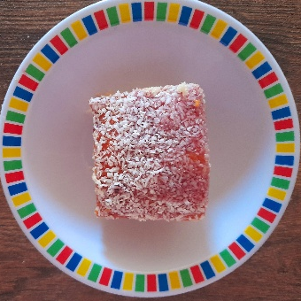
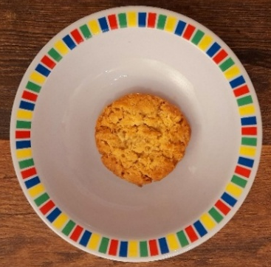
WEEK TWO
 | MONDAY | TUESDAY | WEDNESDAY | THURSDAY | FRIDAY
OPTION 1 | Fish finger wrap with wedges | Beef Chilli with Rice & Sweetcorn & Cucumber Salsa | Roast Pork, Roast Potatoes & Gravy | Greek Chicken Pitta with Herby Rice | Battered Fish with Chips & Tomato Ketchup
OPTION 2 | Summer Pizza with salas | Spaghetti & Vegan Meatballs in a Tomato Sauce | Vegetarian Wellington, Roast Potatoes & Gravy | Spinach & Cheese Whirl with Herby Rice & Tzatziki | Cheesy Broccoli Frittata with Chips & Tomato Ketchup
DESSERT | Iced Vanilla Sponge | Peaches & Ice Cream | Freshly Chopped Fruit | Jam & Coconut Sponge with ice cream | Oaty Cookie
*VEGETABLES AND SIDES MAY DIFFER THAN THOSE SHOWN

Slide 3


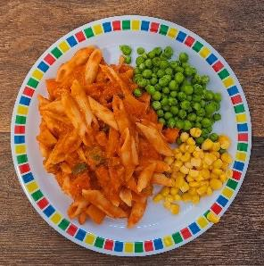
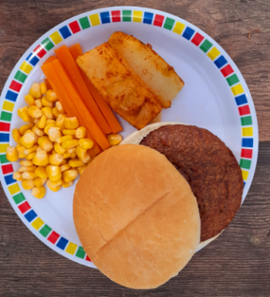
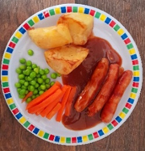
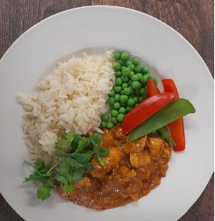
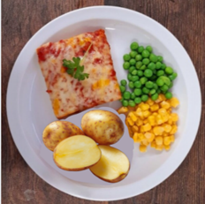
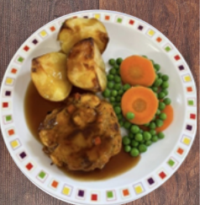
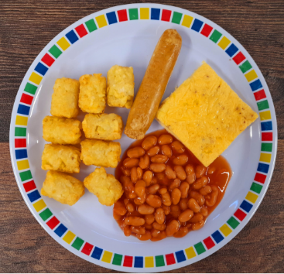
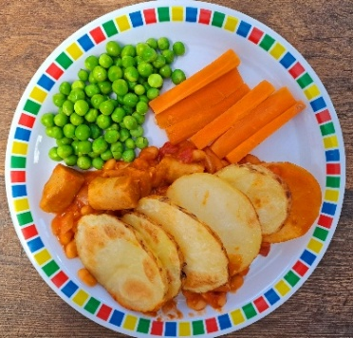
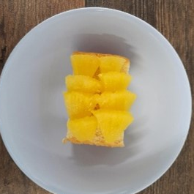
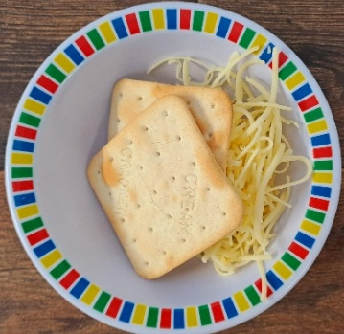
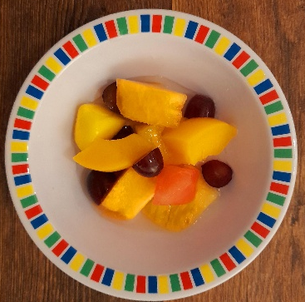
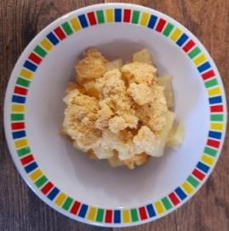
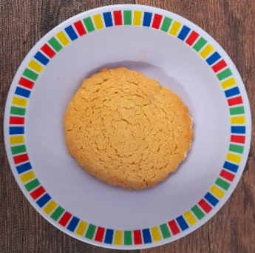
WEEK THREE
 | MONDAY | TUESDAY | WEDNESDAY | THURSDAY | FRIDAY
OPTION 1 | Tomato Pasta | Beef Burger with Potato Wedges & Rainbow Slaw | Chicken Sausage, Roast Potatoes & Gravy | Chef Shilpa’s Chicken Korma with Rice | Fish Fingers with Chips & Tomato Ketchup
OPTION 2 | Cheese & Tomato Pizza with wedges | Mexican Bean Roll with New Potatoes & Rainbow Slaw | Vegetable Loaf, Mashed Potatoes & Gravy | All Day Vegetarian Breakfast | Cowboy Sausage and Bean Hotpot
DESSERT | Pineapple Upside Down Cake | Cheese & Crackers | Fruit Medley | Strawberry & Apple Crumble with ice cream | Vanilla Shortbread
*VEGETABLES AND SIDES MAY DIFFER THAN THOSE SHOWN

Slide 4



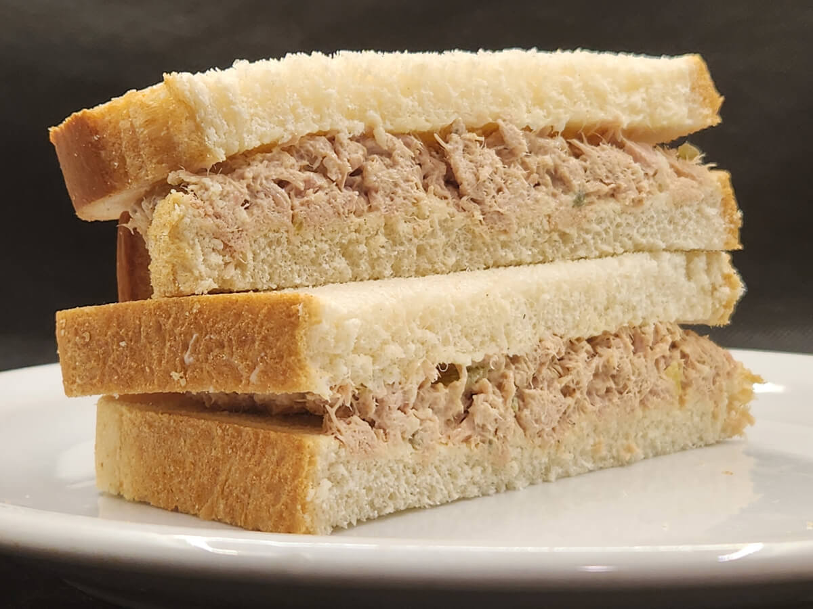
Jacket potato and sandwich options
 | MONDAY | TUESDAY | WEDNESDAY | THURSDAY | FRIDAY
JACKET POTATO (beans, cheese or tuna)
HAM SANDWICH
CHEESE SANDWICH
TUNA SANDWICH

